Slide 1
Sales Target Analysis
Created by : Sanjay Kannan
Last Updated : 16 November, 2023

Slide 2
AGENDA
Business Problem
Understanding the Data
Sales Over Time
Product Analysis
Manager Analysis
Location Analysis
Target Analysis
Conclusion

Slide 3
Business Problem

Slide 4
In order to strategically optimize sales performance, ABC Company seeks to leverage three years' worth of comprehensive sales data, encompassing details of companies and their lines of business.
The dataset includes dimensions such as company details and product categories.
Alongside this, the company possesses targeted sales data.
The objective is to conduct a thorough analysis of the sales landscape from 2017 to 2019, identifying patterns, trends, and areas of improvement.
Through this analysis, ABC Company aims to gain actionable insights that will guide informed decision-making and aid in setting realistic and achievable sales targets moving forward."

Slide 5
Understanding the Data

Slide 6
In our analysis, we have five crucial datasets: Dimensions, Sales 2017, Sales 2018, Sales 2019, and Targets.
Dimensions Dataset:
Provides structural insights with tables for Customers, Products, Product Groups, Salespersons, and Dates.
Offers a foundational understanding of customers, products, sales teams, and temporal aspects.
Sales 2017, Sales 2018, Sales 2019 Datasets:
Essential for detailed sales performance analysis.
Transaction details, customer information, sales team performance, product details, and
overall sales metrics are captured.
Enables in-depth exploration of sales dynamics, customer behavior, product
performance, and sales team effectiveness.
Target Dataset:
Specifies sales targets for each month in 2017 and 2018.
Serves as a benchmark for setting and measuring performance.

Slide 7
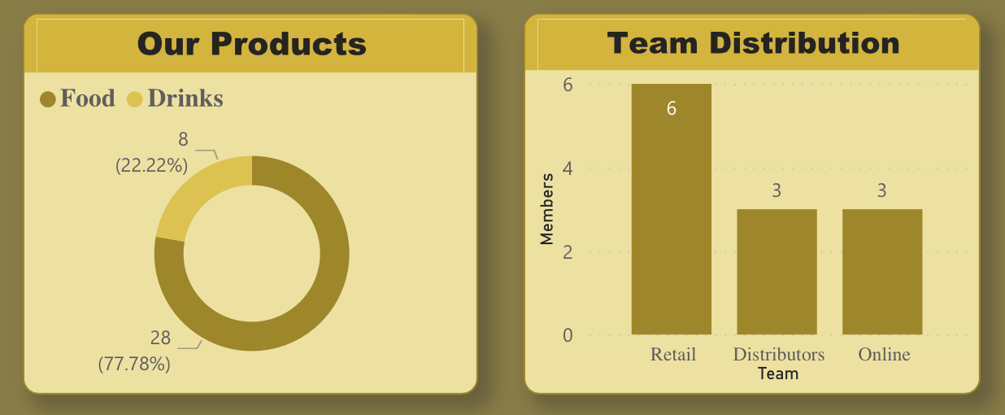
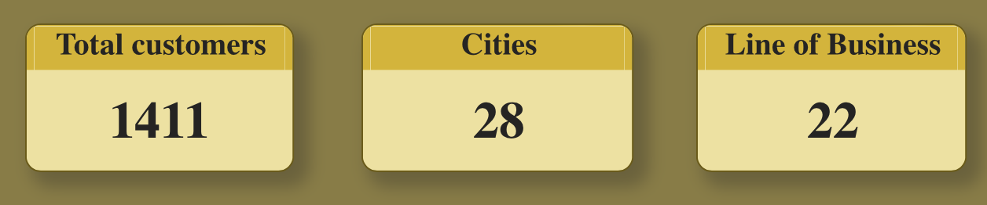
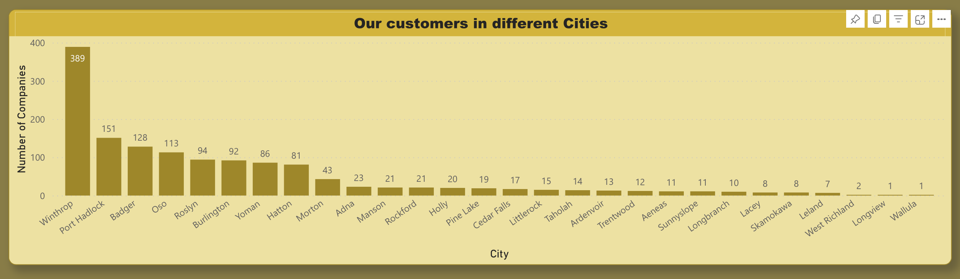
Dimensions

Slide 8
Sales over Time

Slide 9
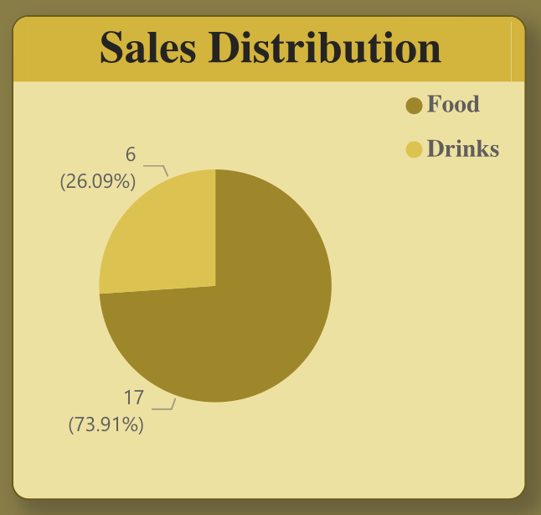
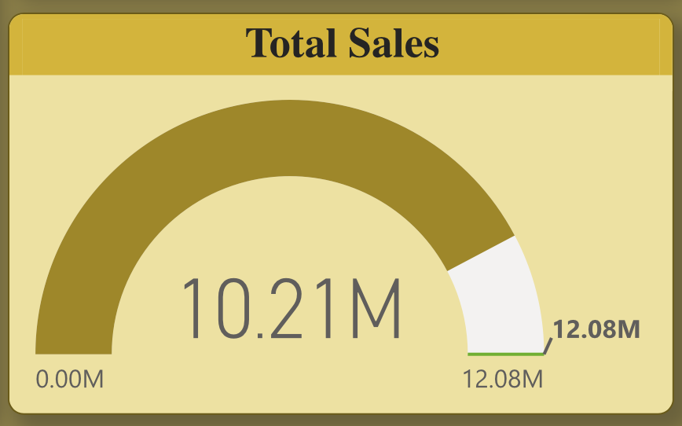
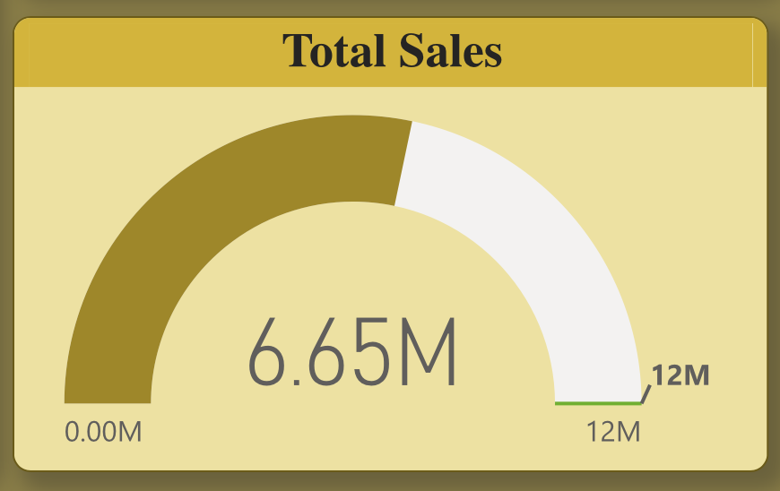
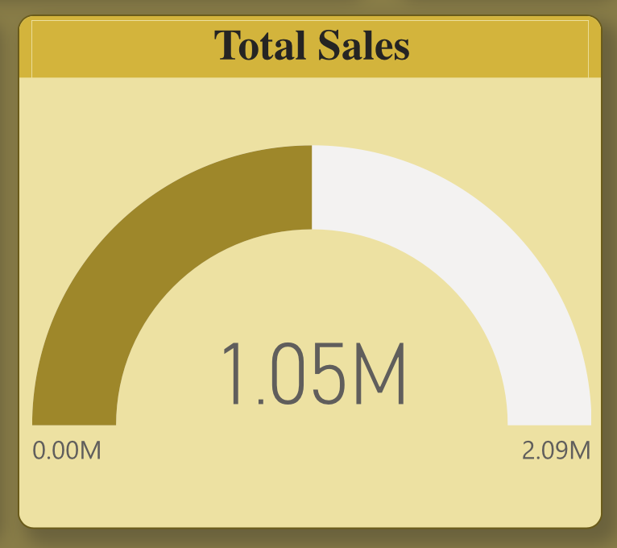
Product Category Dynamics:
The analysis reveals that sales of Food products surpassed those of Drinks, emphasizing the stronger market demand for Food items throughout the observed period.
Overall Sales Performance:
The total sales for the period under consideration amounted to an impressive $17.91 million, showcasing a substantial revenue stream for ABC Company.
Quantity Sold:
In addition to revenue, the company achieved a notable sales quantity of 6,381,172 units, indicating a robust market presence and significant consumer engagement.
Sales Trend Implications:
The preference for Food products aligns with consumer trends and demands, suggesting potential opportunities for targeted marketing and product expansion in this category.
Strategic Insights:
Understanding the quantity sold alongside revenue provides insights into both market share and profitability, aiding in strategic decision-making for future sales initiatives.

Slide 10
Product Analysis

Slide 11
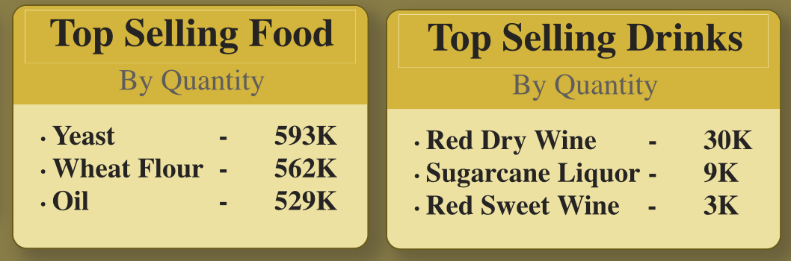
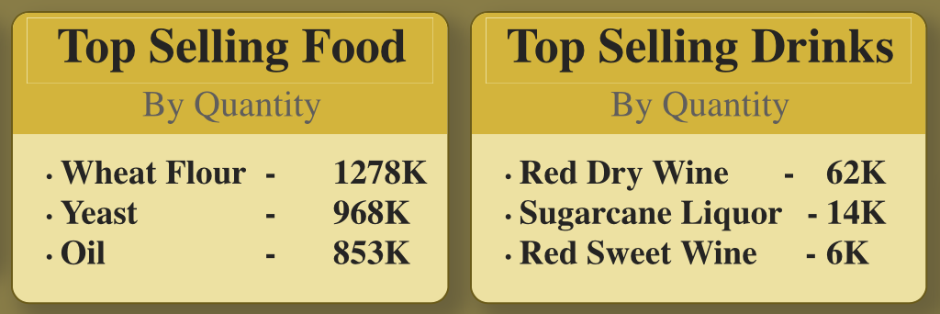
Top Selling Food Products:
Within the Food category, the top three selling products were identified as Yeast, Wheat flours, and Oil. These products demonstrated consistent popularity and demand, contributing significantly to the overall Food sales.
Top Selling Drinks:
In the Drinks category, the leading products were Red Dry Wine, Sugarcane Liquor, and Red Sweet Wine. These items emerged as the preferred choices within the Drinks segment, indicating consumer preferences and potential market trends.
2017
2018
Continued on next page

Slide 12
Revenue Contribution:
The prominence of these top-selling products highlights their significant contribution to overall revenue. Focused marketing strategies and inventory management for these key products can further enhance profitability.
Diversification Opportunities:
Identifying and understanding the top-selling products allows for strategic diversification efforts.
Exploring complementary products or variations of these best-sellers can tap into existing consumer preferences and expand the product portfolio.
Inventory Optimization:
Efficient inventory management and supply chain strategies can be devised by concentrating efforts on the most popular products, ensuring adequate stock levels to meet consumer demand while minimizing excess inventory costs.

Slide 13
Manager Analysis

Slide 14
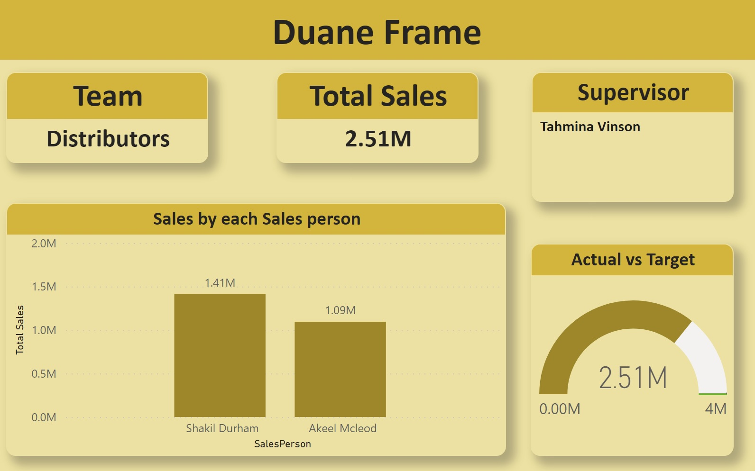
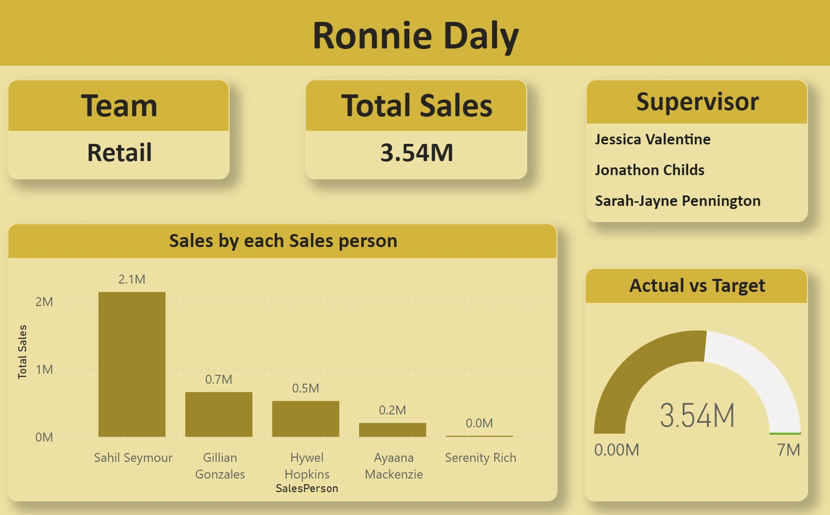
Top Performing Managers:
Duane Frame, managing Distribution and Online sales, emerged as the best-performing manager with a remarkable sales achievement of $9.21 million.
Ronnie Daily, overseeing the Retail segment, closely followed with an impressive sales contribution of $8.70 million.
Sales Breakdown by Segment:
Within the Retail segment, Sahil Seymour demonstrated outstanding performance by generating sales of approximately $4.71 million out of the total segment sales of $8.70 million.
In the Distributors segment, Sahil Durham played a key role, contributing around $3.30 million out of the total segment sales of $6.10 million.
In the Online segment, Dominykas Bird excelled with sales of approximately $1.68 million out of the total segment sales of $3.11 million.
Continued on next page

Slide 15
Implications for Performance Recognition:
Recognizing and rewarding top-performing managers and salespersons is essential for boosting morale and fostering a culture of excellence.
It encourages healthy competition and motivates the team to achieve and surpass sales targets.
Strategic Decision-Making:
Identifying top-performing managers and salespersons provides valuable insights for strategic decision-making.
It enables the company to allocate resources effectively, tailor training programs, and implement targeted incentives to further enhance overall sales performance.
Potential for Knowledge Transfer:
High-performing individuals can serve as mentors or trainers, sharing best practices and strategies with other team members.
This knowledge transfer can contribute to the overall skill development and success of the entire sales team.

Slide 16
Location Analysis

Slide 17
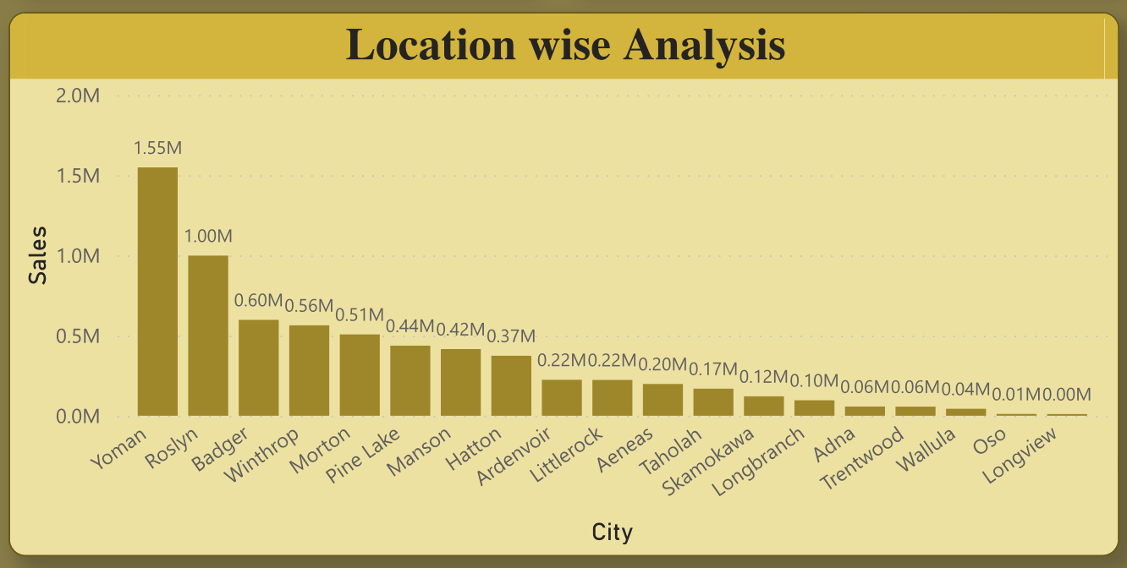
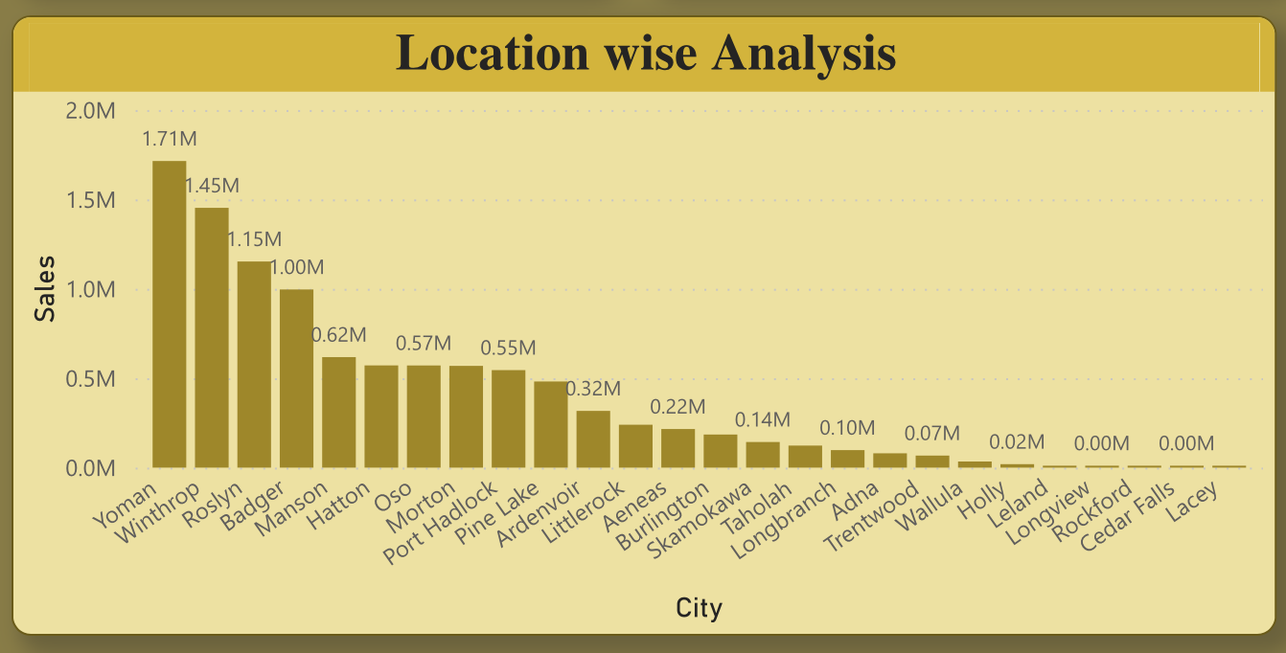
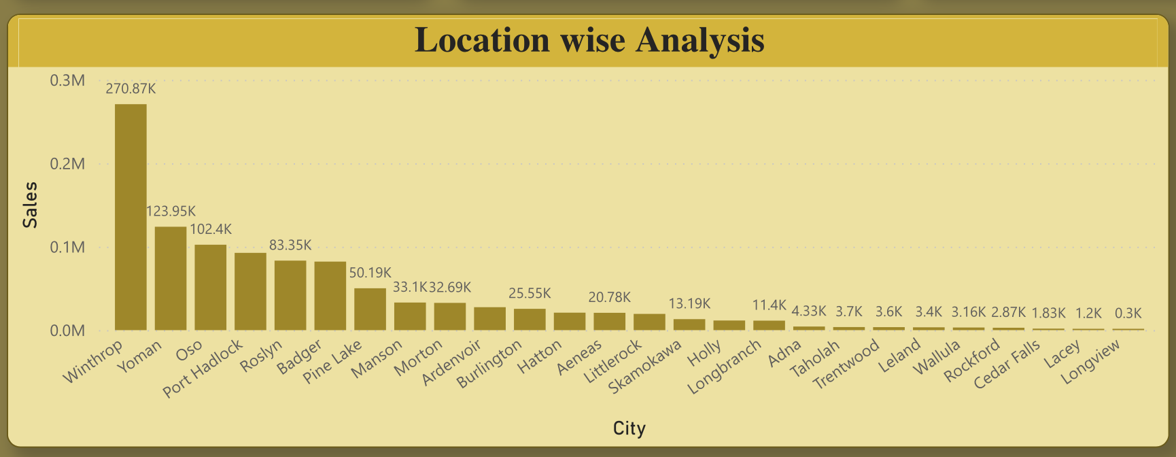
Top Sales Locations:
The analysis reveals the top six sales locations, each contributing significantly to the overall revenue:
Yoman - $3.39 million
Winthrop - $2.29 million
Roslyn - $2.23 million
Badger - $1.68 million
Morton - $1.11 million
Manson - $1.07 million
2017
2018
2019
Continued on next page

Slide 18
Strategic Focus Areas:
Identifying and prioritizing these top sales locations provides insights for strategic planning and resource allocation.
Focusing marketing efforts and sales initiatives on these high-performing locations can yield optimal returns.
Regional Dynamics:
Understanding the regional dynamics, including demographics and consumer behavior, can inform localized marketing strategies.
Tailoring promotions and product offerings to meet the preferences of each location can enhance market penetration.
Opportunities for Expansion:
Recognizing top sales locations presents opportunities for targeted expansion.
Exploring neighboring areas or similar markets can leverage the success of these locations and contribute to overall business growth.
Performance Benchmarking:
These top-performing locations serve as benchmarks for evaluating the success of sales initiatives.
Regular performance assessments can identify trends, capitalize on successes, and address challenges to maintain and improve overall regional performance.

Slide 19
Target Analysis

Slide 20
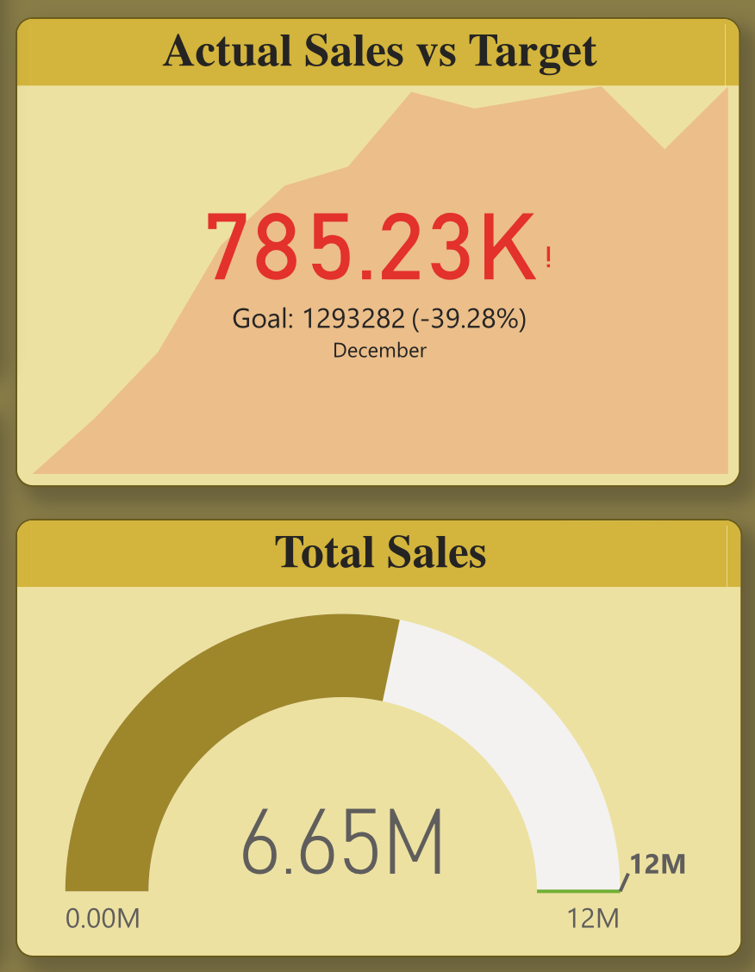
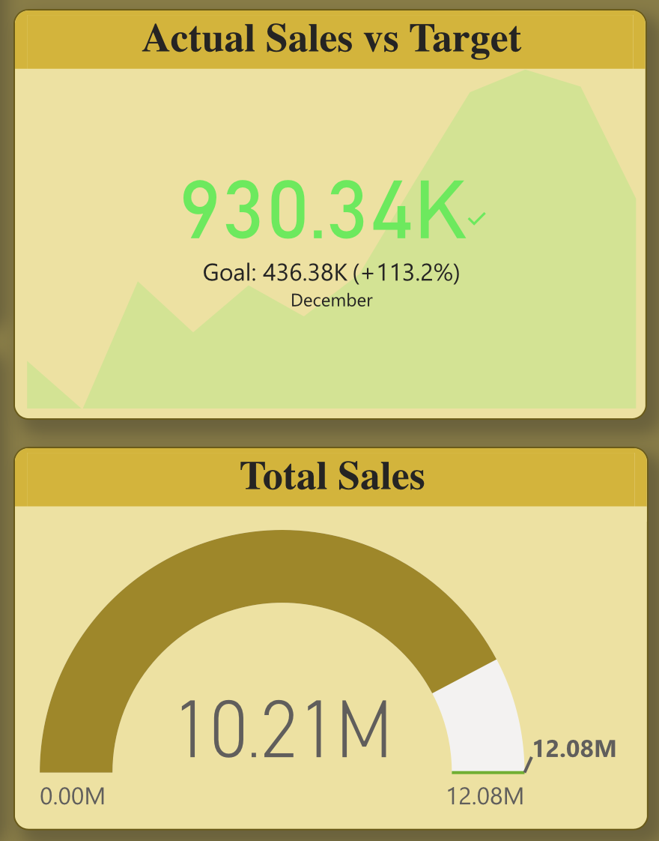
Yearly Target Growth:
A comparative analysis between 2017 and 2018 reveals a substantial 30% increase in the yearly sales target.
This upward adjustment signifies an ambitious strategic approach, indicating confidence in the company's growth potential.
2017
2018
Continued on next page

Slide 21
Monthly Target Achievements in 2017:
In 2017, the Retail and Distributors teams demonstrated commendable performance by achieving the monthly sales target in May, August, and September.
While the achievement was limited to three months, it underscores the strategic importance of these teams in meeting or surpassing set targets.
Monthly Target Achievements in 2018:
The sales teams exhibited notable improvement in 2018, achieving the monthly sales target in seven out of twelve months.
This enhanced performance indicates a more consistent and sustained effort in meeting the set targets, reflecting increased efficiency and strategic alignment.
Product Sales Growth:
A noteworthy observation is the doubling of sold products when comparing 2017 and 2018.
This substantial increase in product sales signifies not only improved market demand but also the company's ability to scale and meet growing customer expectations.
Continued on next page

Slide 22
Limited Insights for 2019:
The analysis of 2019 is constrained by the availability of only three months' worth of data. With limited insights, it becomes challenging to draw conclusive observations.
However, this period can be considered for early trend analysis and initial performance assessment.
Implications for Strategic Planning:
The consistent achievement of monthly targets in 2018 suggests improved strategic planning and execution.
This success can be attributed to refined sales strategies, enhanced team collaboration, and a responsive approach to market dynamics.
Performance Metrics for Evaluation:
The target analysis serves as a critical performance metric, offering insights into the effectiveness of sales strategies and the adaptability of teams.
Regular evaluations can leverage these insights to refine future target-setting processes and align them with evolving business objectives.

Slide 23
Conclusion

Slide 24
Successful Target Growth: Achieved a remarkable 30% increase in yearly targets from 2017 to 2018, indicating strategic resilience and confidence in business expansion.
Team Performance Optimization: Recognized top-performing managers and sales teams, showcasing their pivotal role in meeting and surpassing monthly targets.
Product and Location Insights: Identified top-selling products and key sales locations, enabling targeted marketing efforts for continued success.
Data-Driven Decision-Making: Utilized detailed sales data for strategic decision-making, leading to improved performance, increased sales, and enhanced market penetration.
2019 Trend Analysis: Limited insights due to only three months of data; however, serves as an early indicator for trend analysis and potential strategic adjustments.
Continued on next page

Slide 25
Holistic Approach to Analysis: Combined dimensions, sales, manager, product, location, and target analyses to form a comprehensive understanding of the sales landscape.
Market Responsiveness: Adapted strategies based on changing market dynamics, resulting in consistent monthly target achievements in 2018.
Strong Product Portfolio: Diversified and expanded product offerings, capitalizing on the popularity of top-selling items for increased revenue.
Regional Expansion Opportunities: Identified high-performing sales locations as potential areas for targeted expansion and market growth.
Continuous Improvement: Utilized performance metrics for regular evaluations, fostering a culture of continuous improvement and adaptability.

Slide 26
THANK YOU
Sanjay Kannan

